Slide 1
Games Bootcamp Persistent Data

Slide 2
Recap
Advanced Scripting Concepts

Slide 3
Table of contents
01
Persistent Data
02
Achievements
03
Leaderboards
Saving/Loading
Rewarding Retention
Rewarding retention

Slide 4
01
Persistent Data

Slide 5

Persistent Data
Any data that persists over different play sessions.
Profiles: player data & progress should be saved barring specific game modes like PERMADEATH
Leaderboards: allows for competition
Unlocks: progress-based or purchases
Settings: settings and preferences should carry over.

Slide 6
Persistent Data (2)
Checkpoint
Manual
Autosave
Players can trigger a save by completing an in-game action such as reaching a target location.
Players can manually save their progress through the menu
The game can trigger a save automatically based on certain conditions including progress and time since last save.

Slide 7
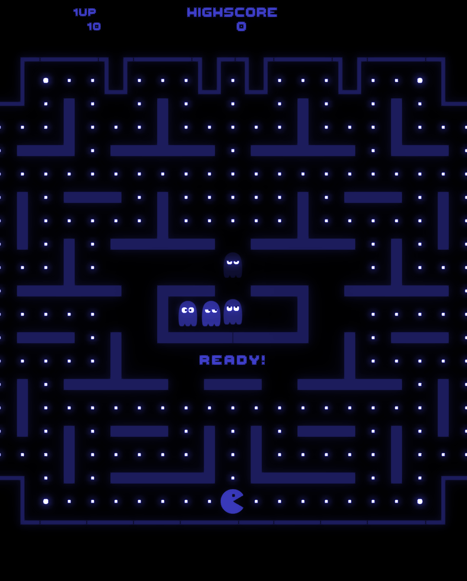
Basic Saving (1)
In our simple example we only have one piece of persistent data; The HIGH SCORE
PlayerPrefs: Unity provides a class for saving basic Types such as int, float, string.
It works like a dictionary with a key-value pair

Slide 8
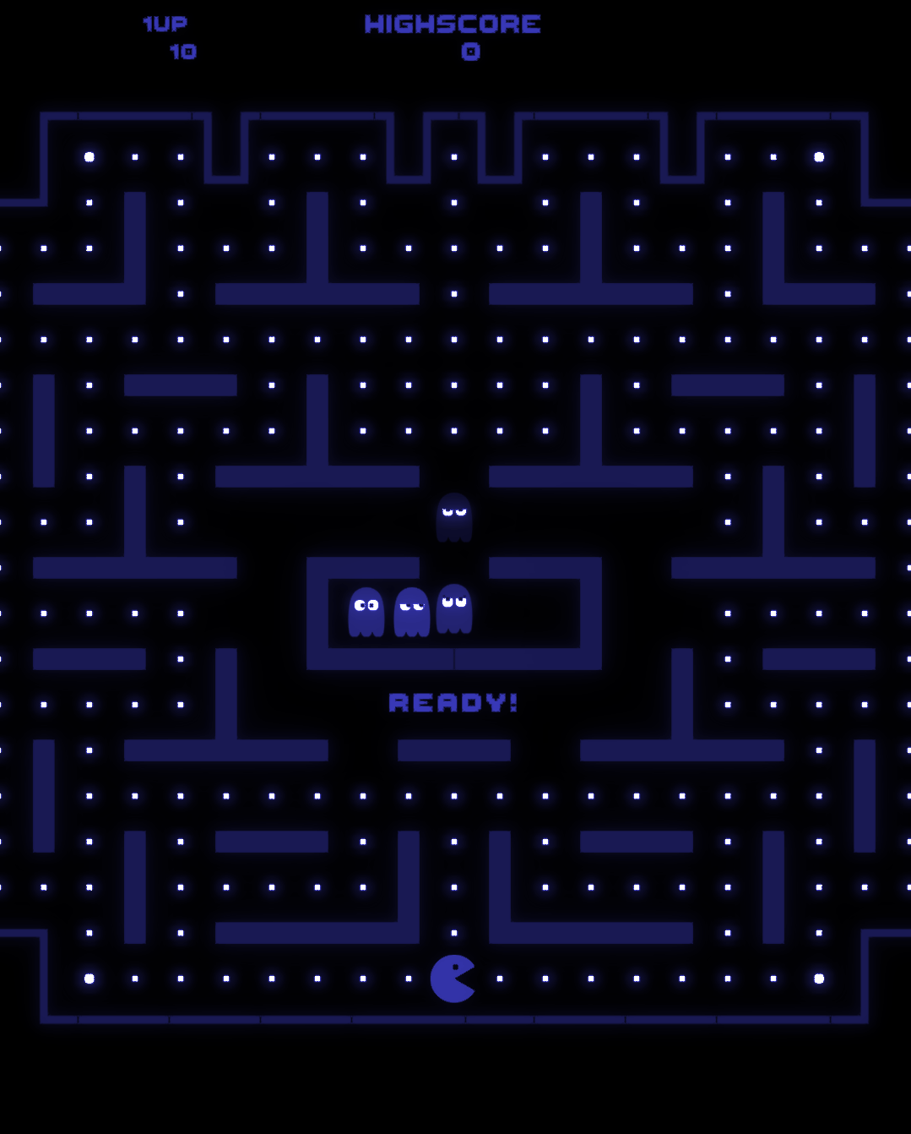
Basic Saving (2)
There is little to no security in this method
It is great for simple local settings such as audio level, graphics settings etc.

Slide 9
Basic Saving Task
Create a simple game with an action that raises a score by one
Tap a Button
‘Pickup’ OnTriggerEnter
Raycast ‘bullet’ on key input.
Create a canvas and add two text gameobjects, score & highscore.
Use PlayerPrefs to keep track of the high score across sessions
Test your game!

Slide 10
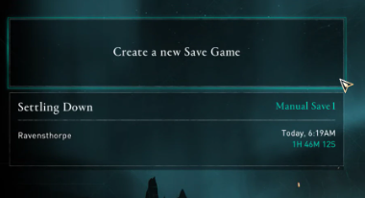
Advanced Saving (1)
Most games are going to be much more complex. You’ll need to save things like:
Player Data
Location
Level Progress
NPC Data
Inventory.

Slide 11
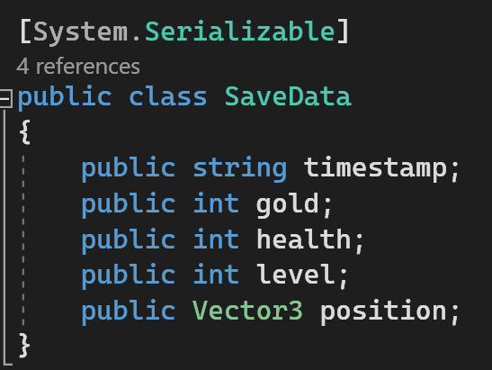
Advanced Saving (2)
Remember the OOP principles
You need to abstract out critical data from your game. What is the critical data?
You need to encapsulate this data into a class that can be passed into our save/load system.

Slide 12
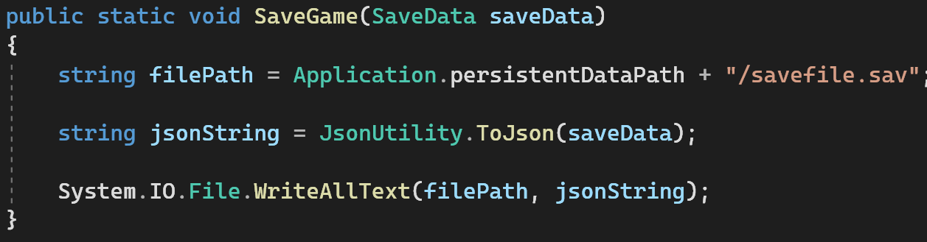
Advanced Saving (3)
We need to convert the data to a readable string and save that string to a folder.

Slide 13
Encryption
No local data will ever be fully secure!
Most games have server authentication.
Data is verified on the server side preventing things like cheat engines.
Local data should still be encrypted.
A simple approach is to take the easily readable JSON and change it to a binary file.

Slide 14
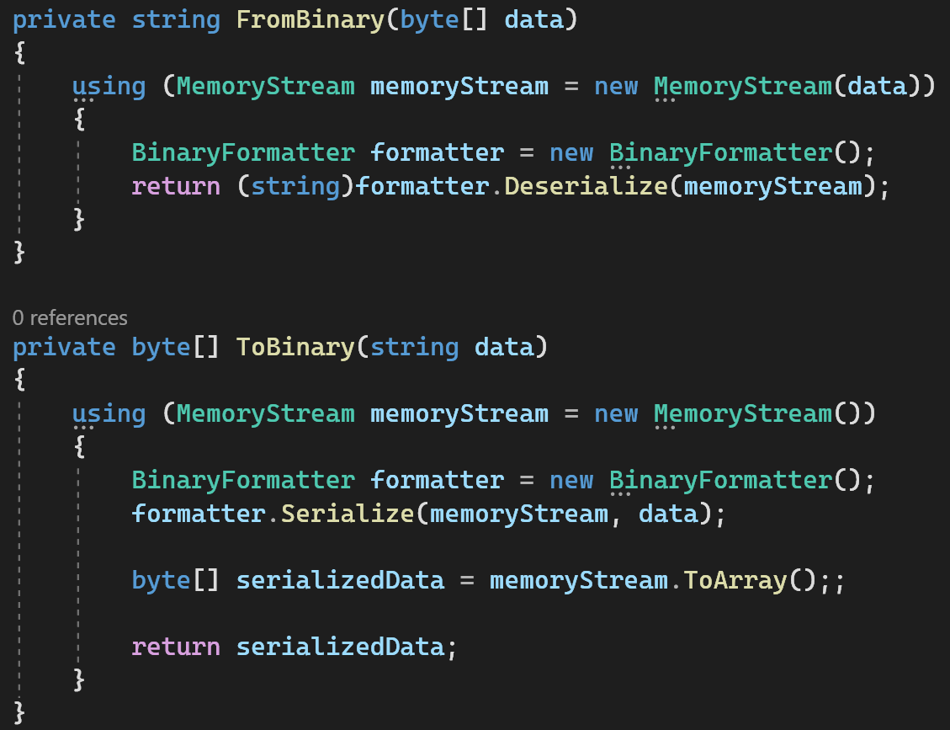

Slide 15
02
Achievements

Slide 16
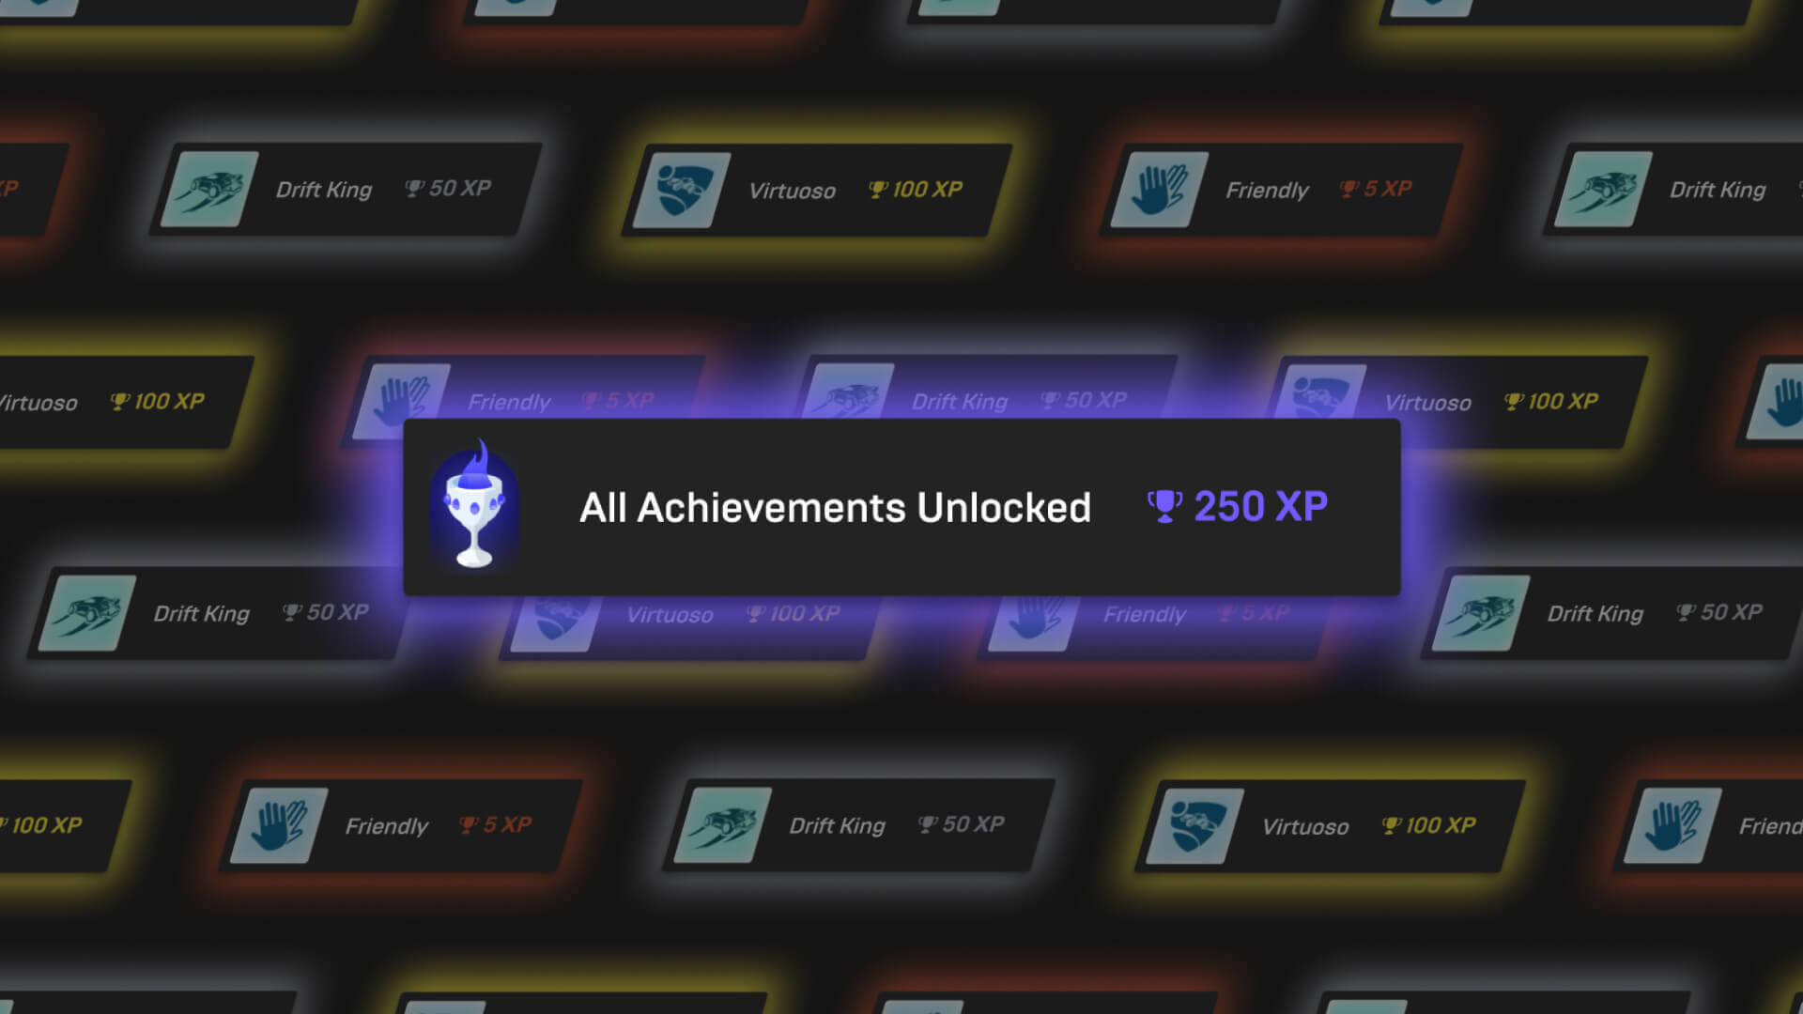
Achievements (1)
Long-term objectives that are usually not bound to a particular level.
We need to create an ‘achievement’ object
Some achievements may take a long time to complete it is not efficient to check these in update
We need a notification system.

Slide 17
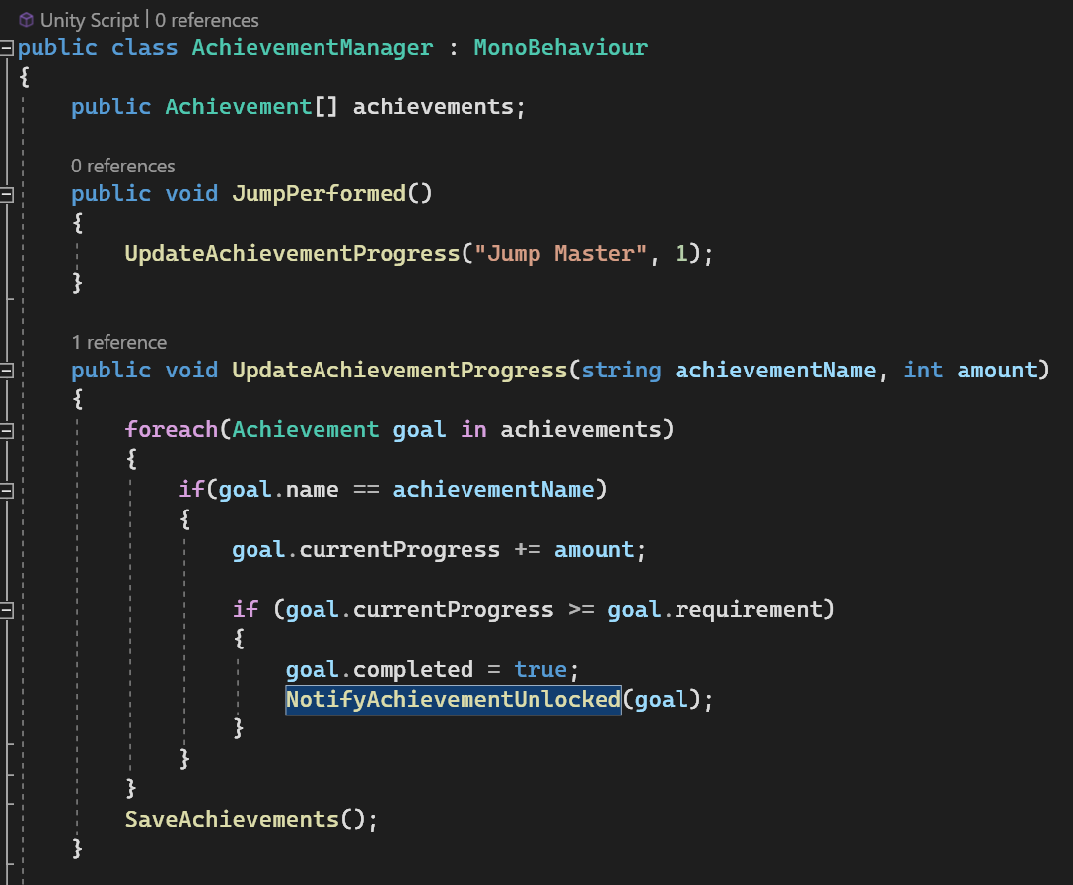
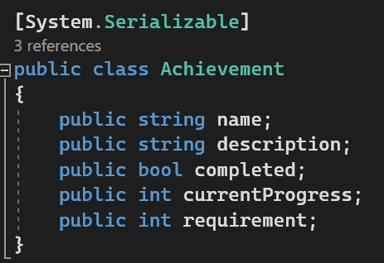
Achievements (2)

Slide 18
03
Leaderboards

Slide 19
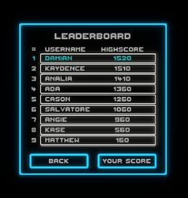
Leaderboards (1)
Let’s use a simple example again with a high score leaderboard.
We are already saving a local high score.
When a new high score is set we need to send it to the leaderboard.

Slide 20

Leaderboards (2)
The leaderboard is stored on a server. This can be done yourself or through a service.
lootlocker.com is free for upto 1000 MAU
Databases are tables with a unique identifier for each row.
lootlocker handles this for us but for other solutions we can use:

Slide 21
Thanks!

